Slide 1
QA System For Historical Events(World War 2)
Team members
Shrey Sinha– 2101AI31
Anshu Nauwala– 2101CS10
DhruV Choudhari– 2101CS25
Group 35

Slide 2
Task Overview
Task 1 : Dataset Collection
Scrape Wikipedia, Documents, Articles etc
Task 2 : Annotation/Population
Form Question-Answer Pairs from quizzes/exams
Task 4: Implement RAG Based Retrieval for inference
Task 3: Finetune T5 for Question Answering

Slide 3
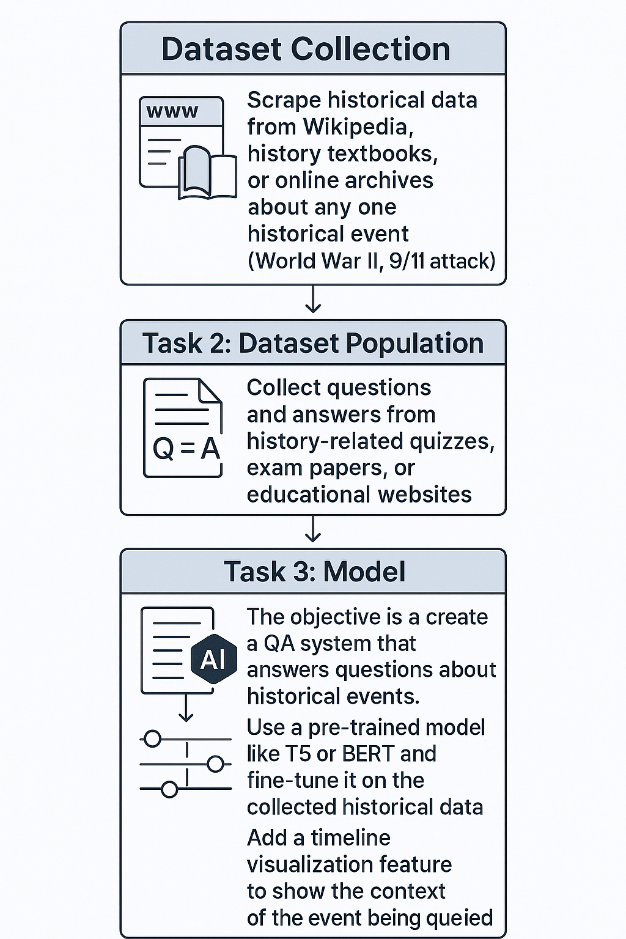
TASK-1 Dataset Collection
• Use Libraries such as Beautiful Soup for Knowledge Base/Document Collection.
•Large Articles are divided to sections (chunking)
•API Calls for Wikimedia Articles
Removal of Citations, References and Preprocessing

Slide 4
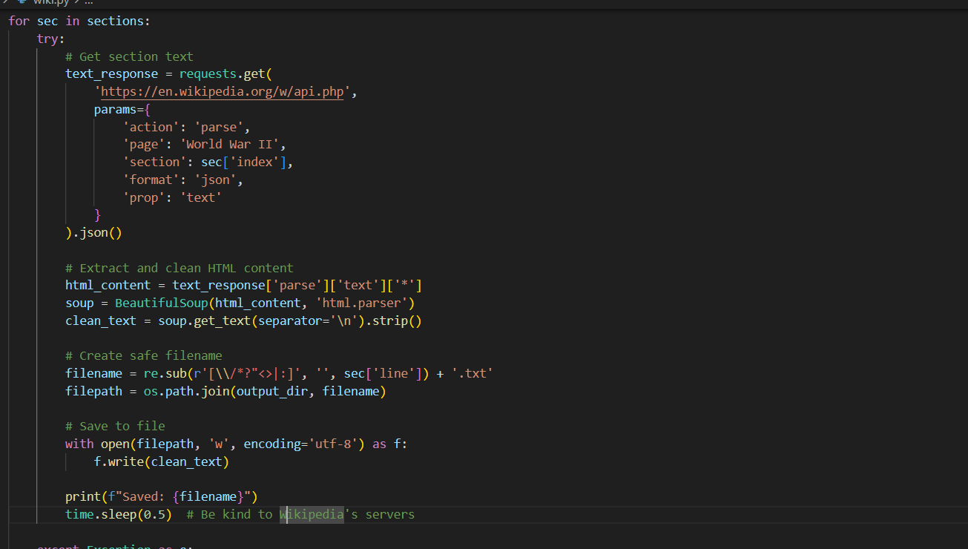

Slide 5
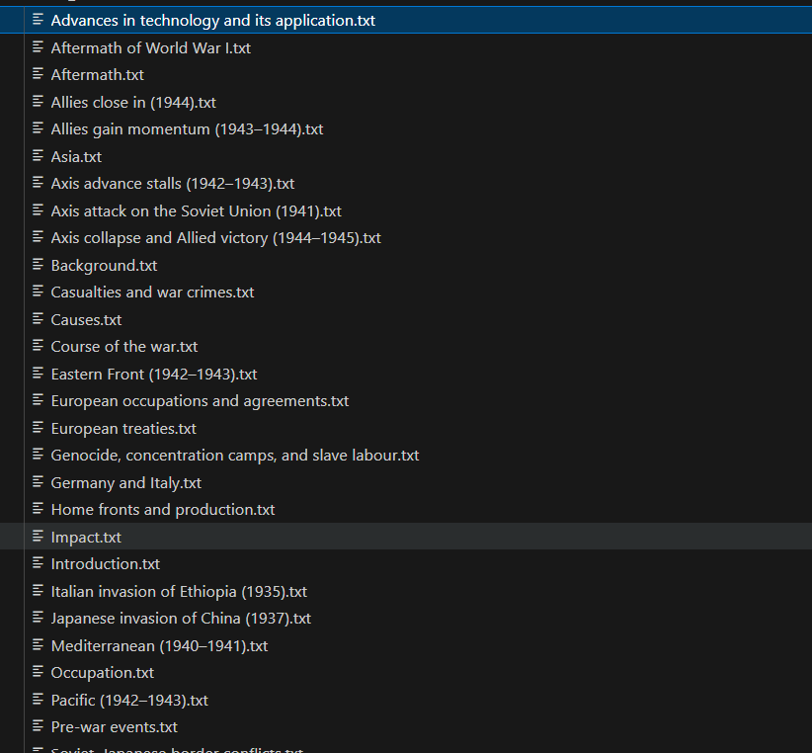
Example of Knowledge Base Set of over 40 Documents, each having around 1000 words

Slide 6
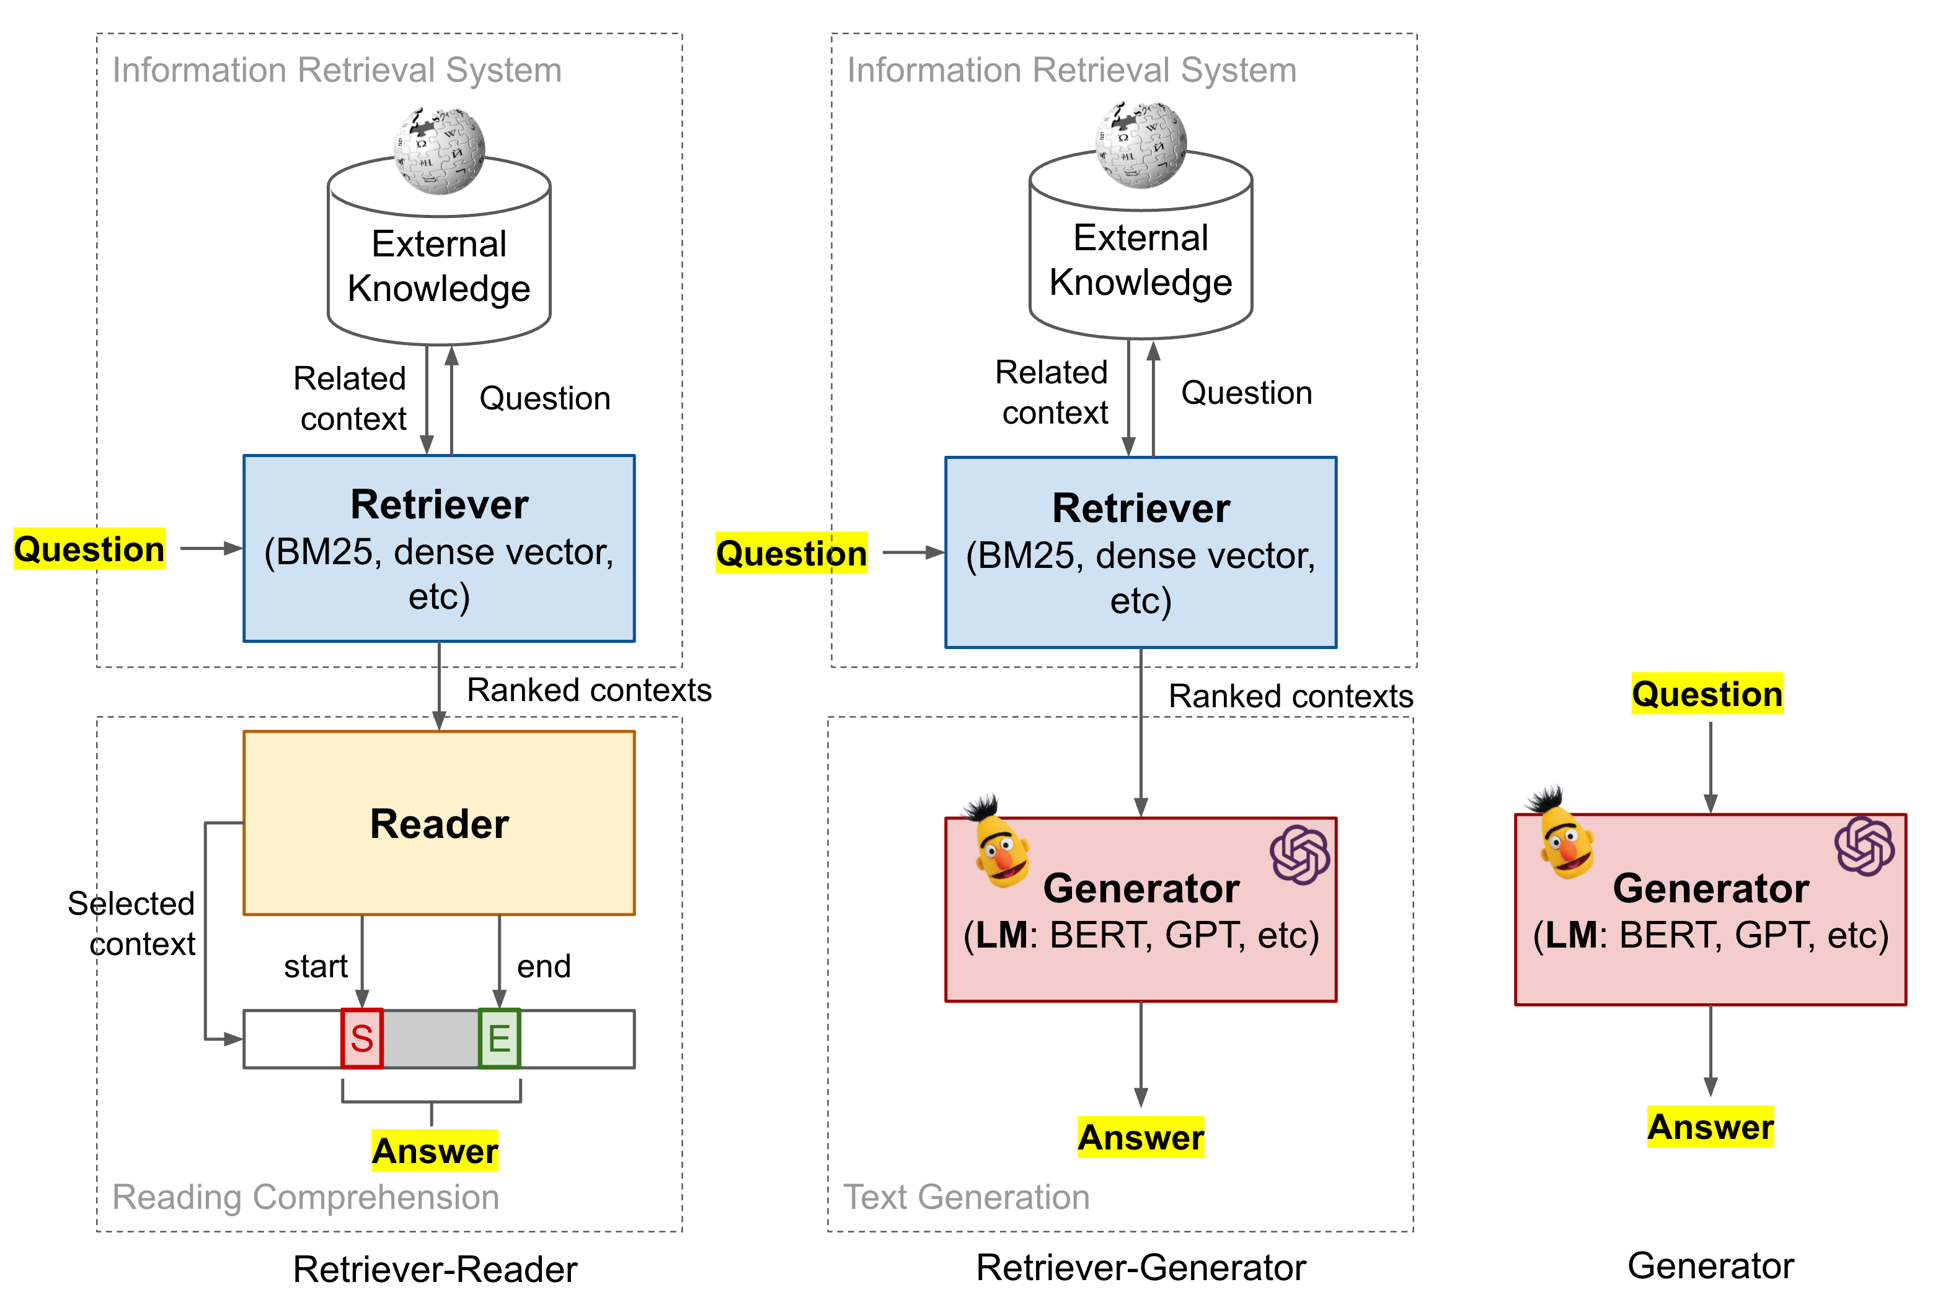
TASK-2 – Population/ Question Answer Formation
•Context: The Document/ Base In which
the answer is present (Input Variable)
• Question: The question asked by the user to
our system (Input Variable)
•Answer: Provided the context and question,
the response generated by our model (Target Varibale)

Slide 7
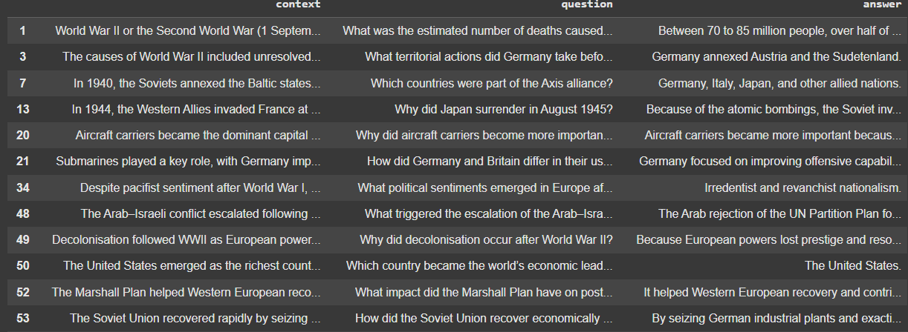
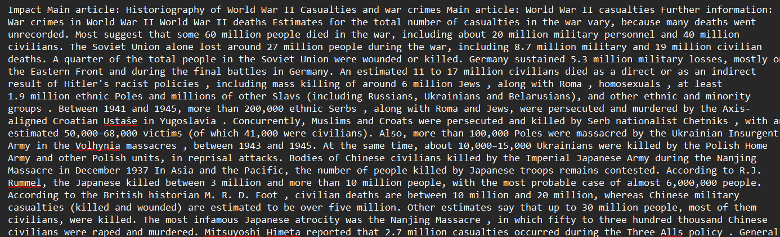
Dataset
CSV File with over 300 context-question-answers tuples
Text file with conversations(set of utterances).
Text Files with information acting as knowledge base during retrieval

Slide 8
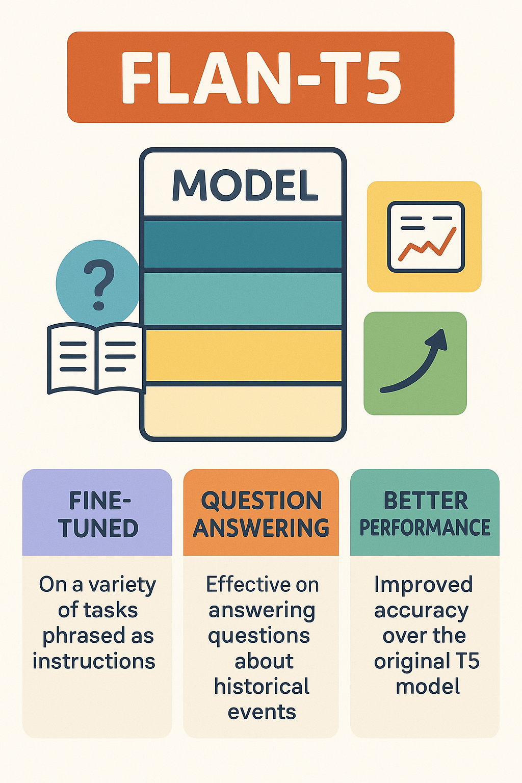
Model Architecture
•Uses Finetuned FLAN T5
Boosting of Performance with RAG based retrieval before answer generation
Evaluated on BLEU and F1 Score
Documents are chunked and indexes are created using FAISS and all-MiniLM-L6-v2 Sentence Embedding
Top 3 Documents are retrieved and used as context for question answering.
A Timeline is maintained by fetching date from questions and answers.

Slide 9
Final Model Flow
Retrieved Context
Knowledge Base
Chunking & Indexing with FAISS
Top 3 Document as Context
Answer
all-MiniLM-L6-v2 Sentence Encoder for Docs
Retriever
Generator(Finetuned FLAN t5)
Timeline
User
Question

Slide 10
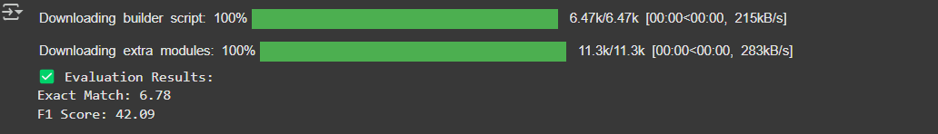
Results
Predictions
Ground Truth

Slide 11
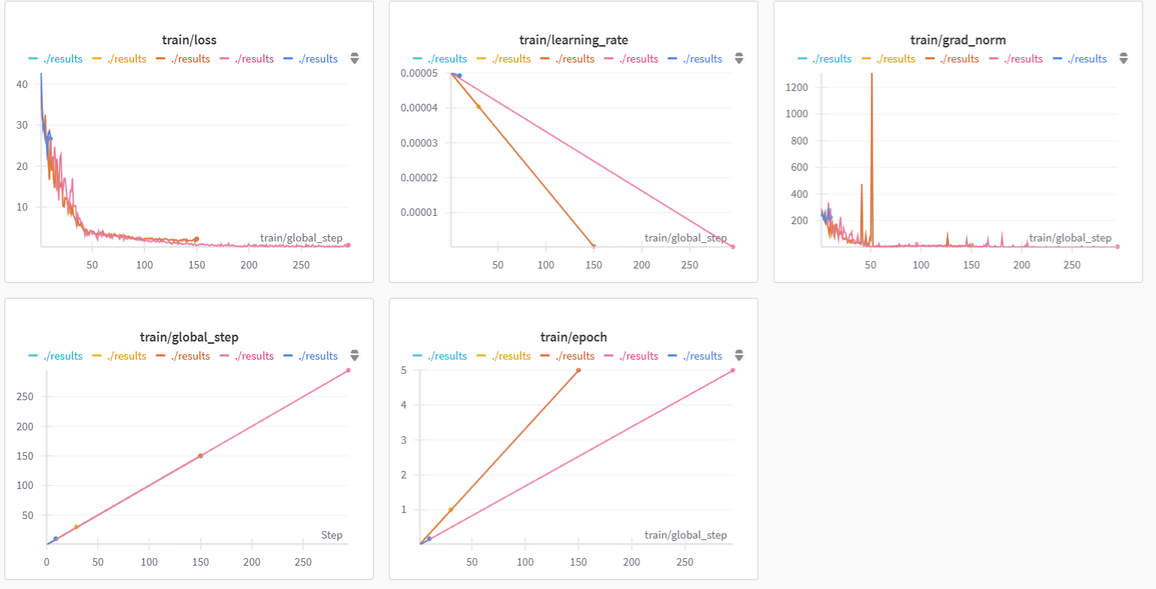
Results

Slide 12
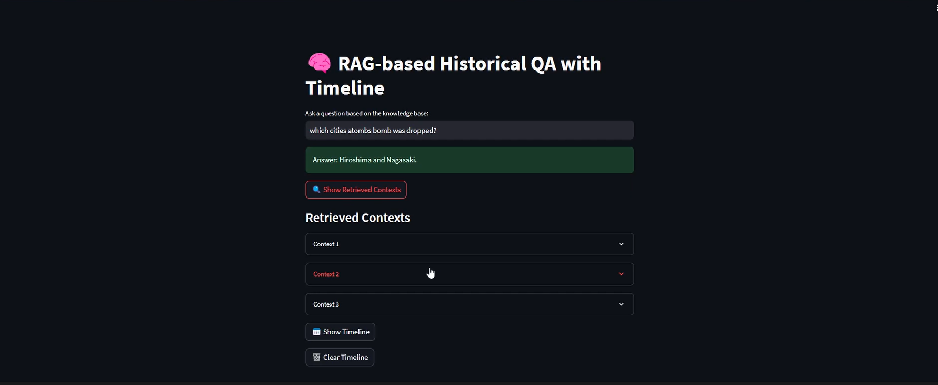
Results

Slide 13
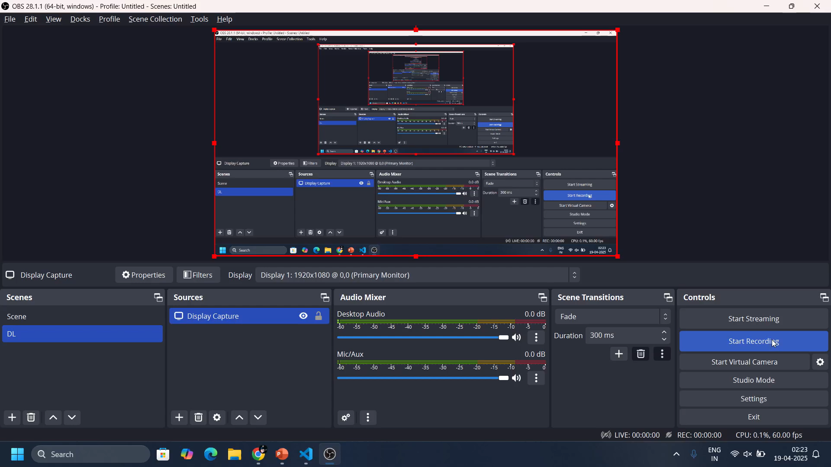
Demo

Slide 14
Contribution
Shrey Sinha– 2101AI31
Built the Retriever and RAG System. Processed documents and deployed the inference engine for end user on the stream lit web app. Built indexes and wrote code for chunking of knowledge base.
Dhruv Choudhari– 2101CS25
Finetuned FLAN T5 for the task and evaluated it on the test and train sets. Monitored the loss graphs and saved various checkpoints for analysis
Anshu Nauwala– 2101CS10
Collected Data through various means (Scrapers, API Calls etc) and Cleaned them. Formed QA Pairs that are used for finetuning and data loaders.

Slide 15
Thank you

